Slide 1

STUDENT NAME: K.Kanniga REGISTER NO: 312200852 DEPARTMENT: B.Com(General) COLLEGE: Pachaiyappa’s College For Women

Slide 2

Employee Turnover Analysis: A Data-Driven Approach
This presentation explores the use of pivot tables to analyze employee turnover data. We will delve into the definition, metrics, and benefits of this powerful tool, and demonstrate its application through a case study.

Slide 3

Overview of Employee Turnover Analysis
1
Definition
Employee turnover refers to the rate at which employees leave a company. It is a critical metric for businesses to track, as it can impact productivity, morale, and profitability.
2
Significance
Understanding the reasons behind employee turnover is crucial for identifying areas for improvement and implementing strategies to retain valuable talent.
3
Impact
High turnover can lead to increased hiring costs, decreased productivity, and a loss of institutional knowledge.

Slide 4

Key Metrics for Turnover Analysis
1
Attrition Rate
2
Time to Fill
The percentage of employees who leave the company voluntarily or involuntarily during a specific period.
The average time it takes to hire a new employee for a vacant position.
3
Cost per Hire
4
Retention Rate
The total cost associated with recruiting and hiring a new employee.
The percentage of employees who remain with the company over a specific period.

Slide 5
Introduction to Pivot Tables
Definition
Functionality
A pivot table is a powerful data analysis tool that allows you to summarize and analyze large datasets by grouping and aggregating data based on different criteria.
Pivot tables enable you to quickly create dynamic reports, identify trends, and gain insights from your data.

Slide 6

Benefits of Using Pivot Tables
Data Summarization
Pivot tables condense large datasets into meaningful summaries, making it easier to understand and interpret data.
Trend Identification
They help identify patterns and trends in data, allowing you to make informed decisions based on insights.
Data Exploration
Pivot tables provide a flexible way to explore data from different angles, uncovering hidden relationships and patterns.

Slide 7

Components of a Pivot Table
Rows
Categories that define the rows of the table.
Columns
Categories that define the columns of the table.
Values
The data that is aggregated and displayed in the table.
Filters
Criteria used to filter the data displayed in the table.

Slide 8
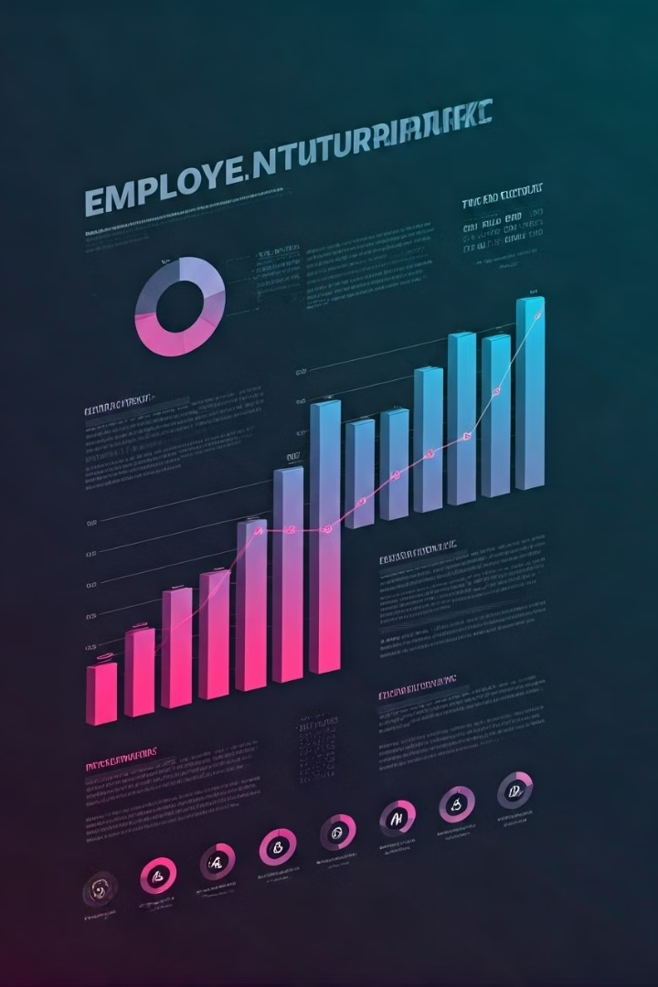



Case Study: Analyzing Employee Turnover
Dataset Overview
The dataset includes information on employee demographics, tenure, department, and reason for leaving.
Pivot Table Analysis
We will use pivot tables to analyze the data and identify key trends and insights.
Chart Visualization
Charts will be used to visually represent the findings and make the data more accessible.

Slide 9
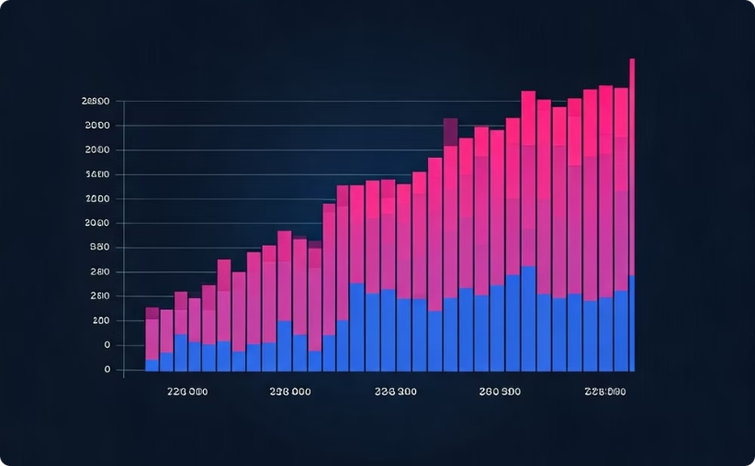
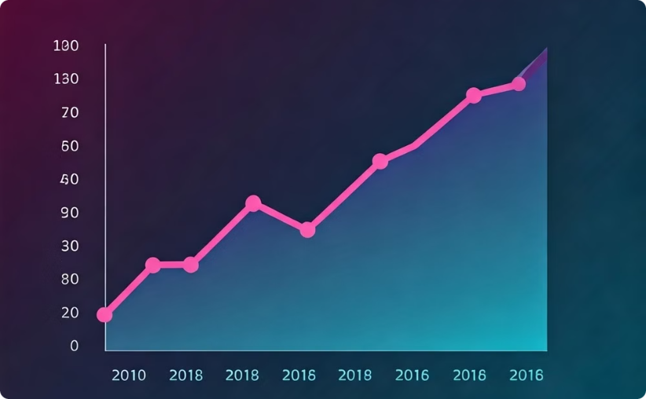
Key Findings from the Analysis
Departmental Variations
Trend Analysis
The analysis revealed significant differences in turnover rates across different departments.
The data indicated an increasing trend in employee turnover over the past few years.

Slide 10




Conclusion & Recommendations
Key Takeaways
The analysis highlighted the importance of addressing employee satisfaction, career development opportunities, and work-life balance.
Recommendations
Implement employee engagement initiatives, provide career development programs, and improve work-life balance policies.
Continuous Monitoring
Regularly monitor employee turnover metrics and adjust strategies as needed.

Slide 11

Next Steps & Closing
Action Plan
Develop an action plan based on the recommendations to address employee turnover.
Implementation
Implement the action plan and track progress over time.
Continuous Improvement
Continuously evaluate and refine strategies to optimize employee retention.

